Slide 1
TITLE

Slide 2
VILNIUS UNIVERSITY

Slide 4
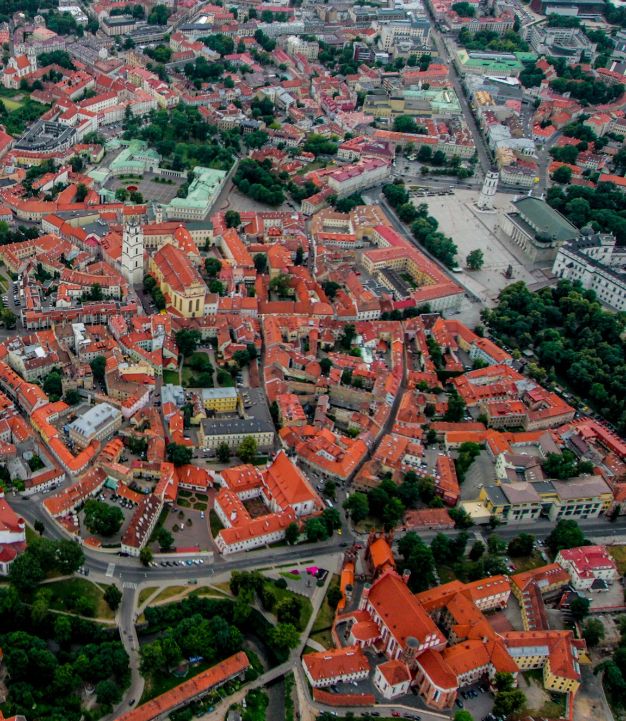

Slide 7
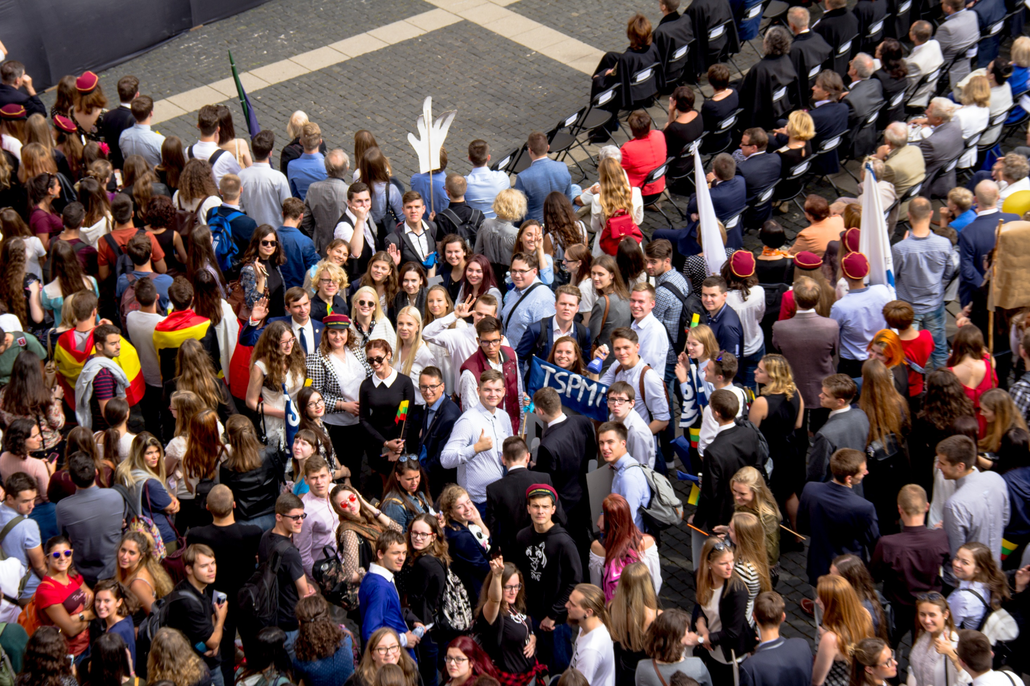

Slide 8
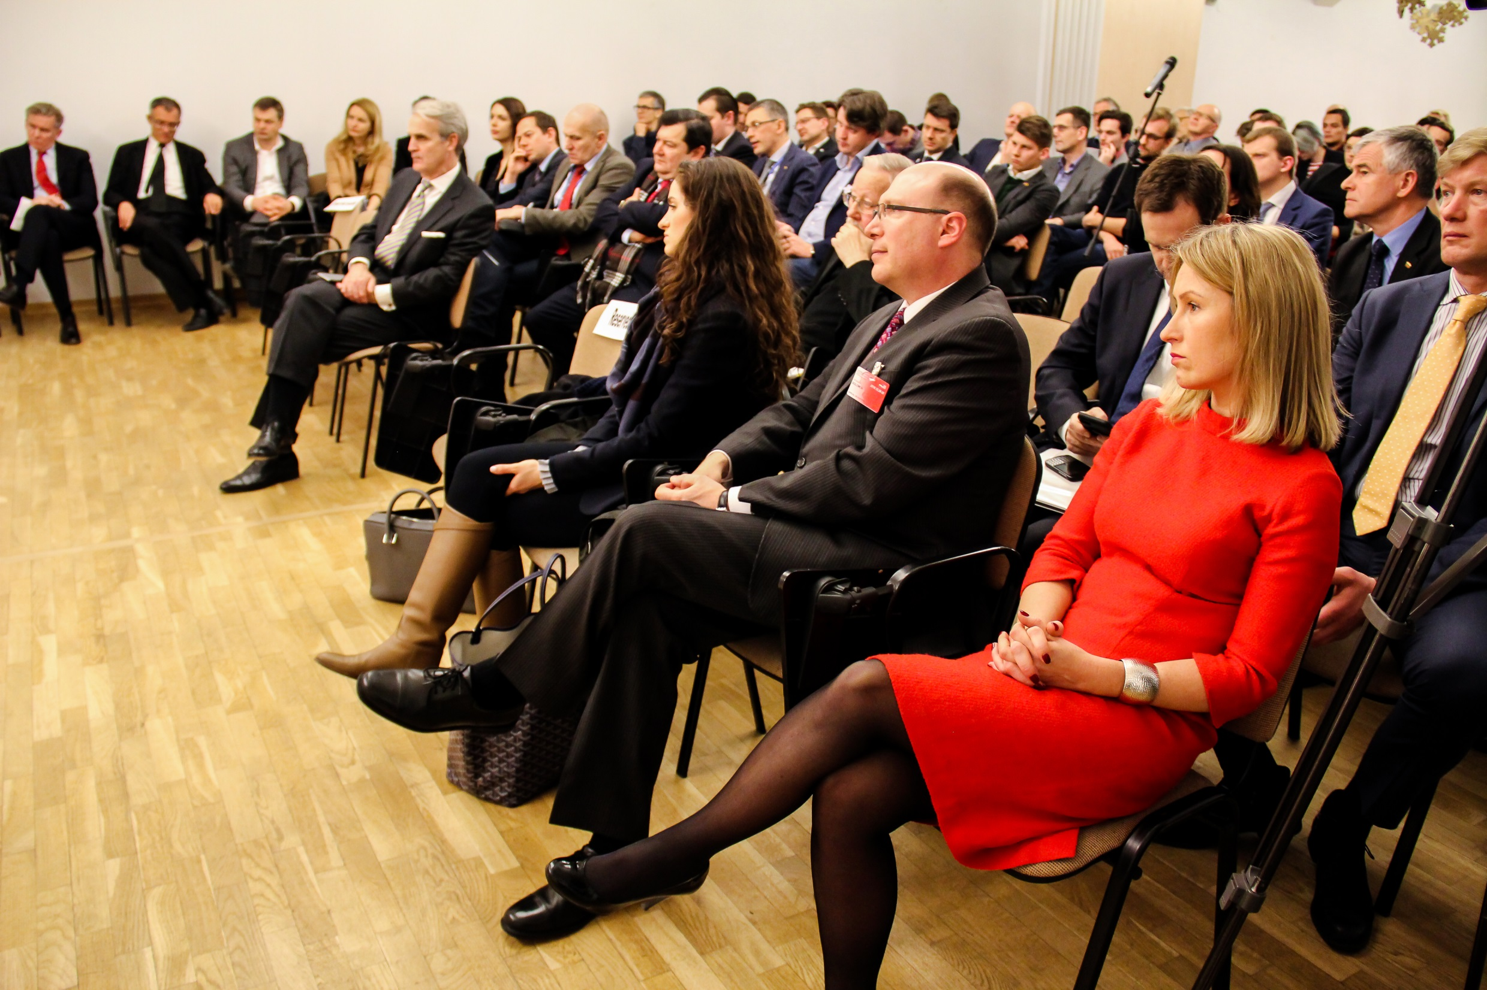

Slide 10
Follow us on social media:
instagram.com/vu_tspmi
fb.com/tspmi
http://www.tspmi.vu.lt

